Slide 1
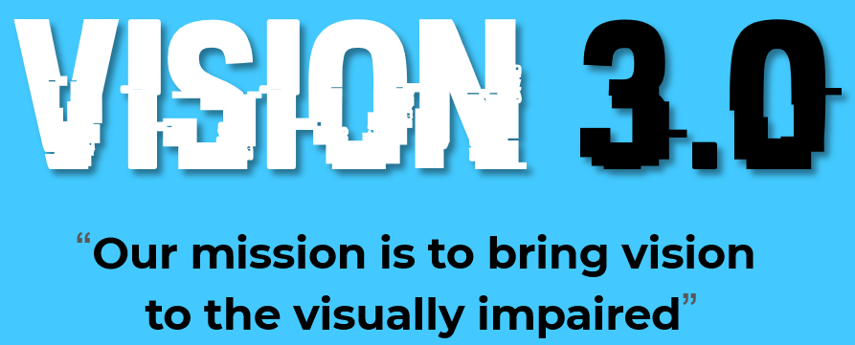






VISION 3.0 “Our mission is to bring vision
to the visually impaired”
TROUBLESHOOTERS🛠️
Notes:
Hi

Slide 2



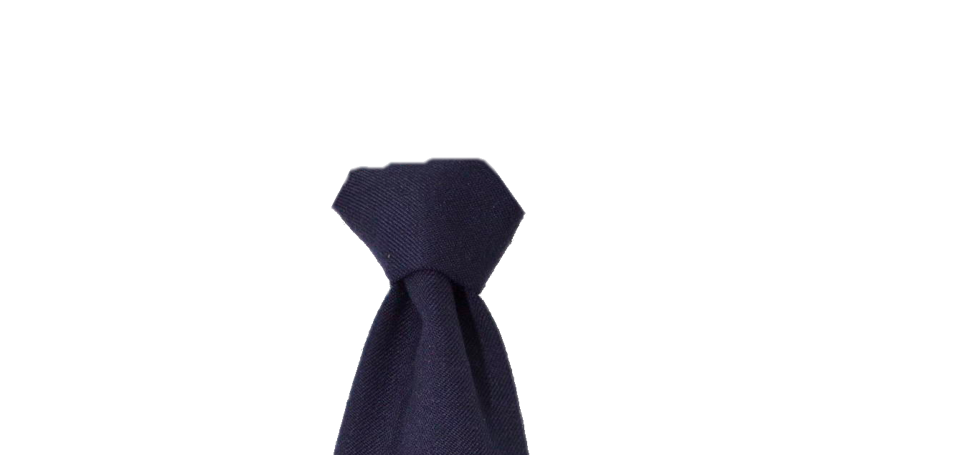
OUR TEAM
TROUBLESHOOTERS🛠️
DHANUSH KUMAR. V
2ND YEAR ECE
SSREC
SRIRAM SANTHOSH. R
2ND YEAR ECE
SSREC
KISHORE. K
2ND YEAR ECE
SSREC
Notes:
talk

Slide 3

PROBLEM STATEMENT
People who are blind have difficulties moving around, reading text, and recognizing objects.
White canes and assistive technologies to detect proximities are available on the market, but they don't help in identifying the object.
1.4 million blind children in the world. At least 200,000 children in India have severe visual impairment or blindness.
People who are blind can read only Braille text and Braille is not available everywhere they go.

Slide 4
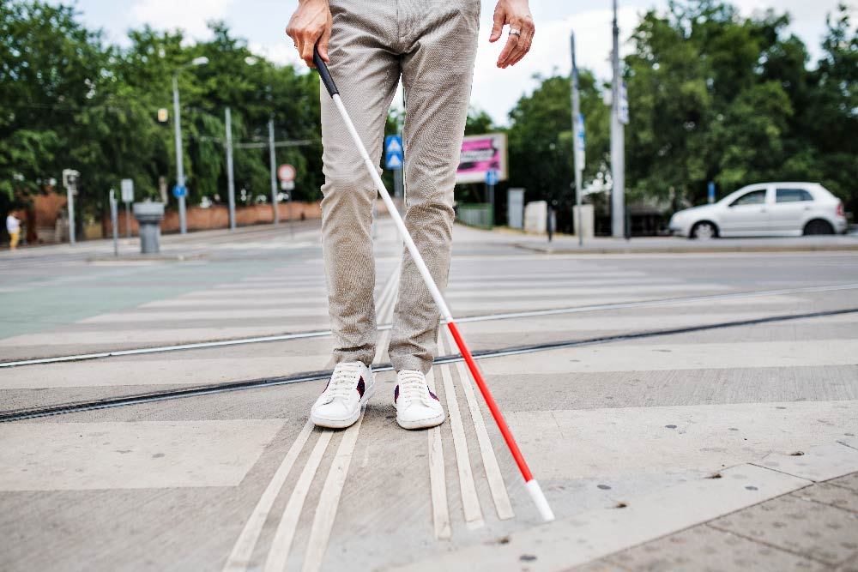
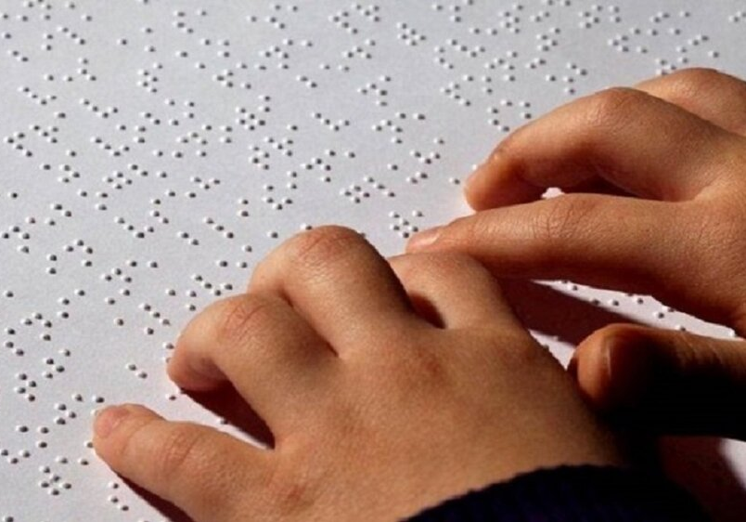
BRAILLE SCRIPT
WHITE CANE

Slide 5
OUR SOLUTION
The proposed idea is to develop an assistive device for the visually impaired.
Our project is an object recognition, text recognition, proximity detection and fall detection system.
This device can be utilized by any adult or child unless the person is not deaf.
With the press of the 1st button, the person can detect any object and hear it as audio, with the press of the 2nd button, the person can recognize text and hear the text.
At other times the device is on standby to avoid unwanted recognition and confusion.
Incase the individual fall down, the device has an emergency mode where the family members are intimated the location.
But, the proximity detection stay’s on the whole time when the device is powered on.
Audio output is to be given in the user’s preferred regional language.

Slide 6
RELEVANCE T0 SDG
The well being and health of a visually impaired person is important.
A device for these blind people will help them with a good mental health and provoke good emotions.
Visually impaired can’t be discriminated just because of their illness. They also have to be treated EQUALLY!
Visually impaired must also get the basic education without any barriers.

Slide 7
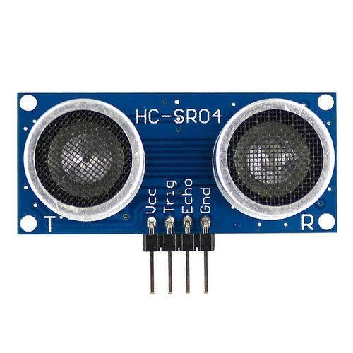
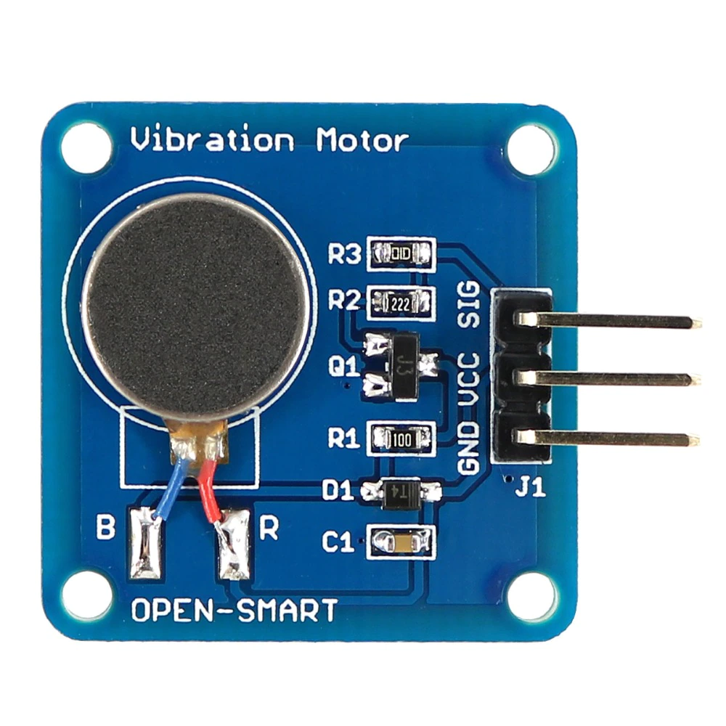
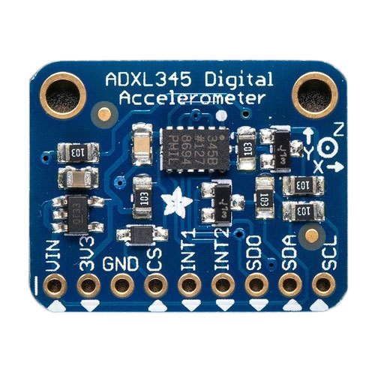
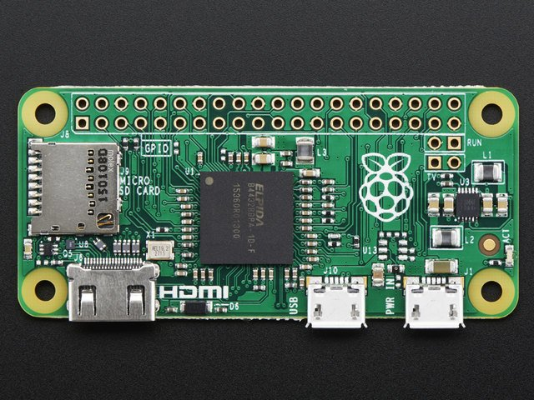
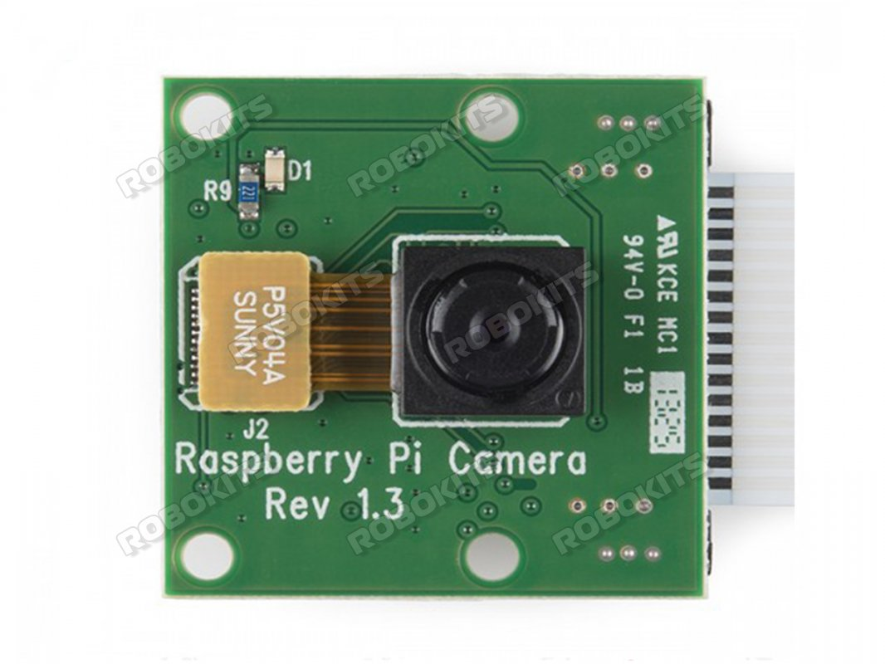
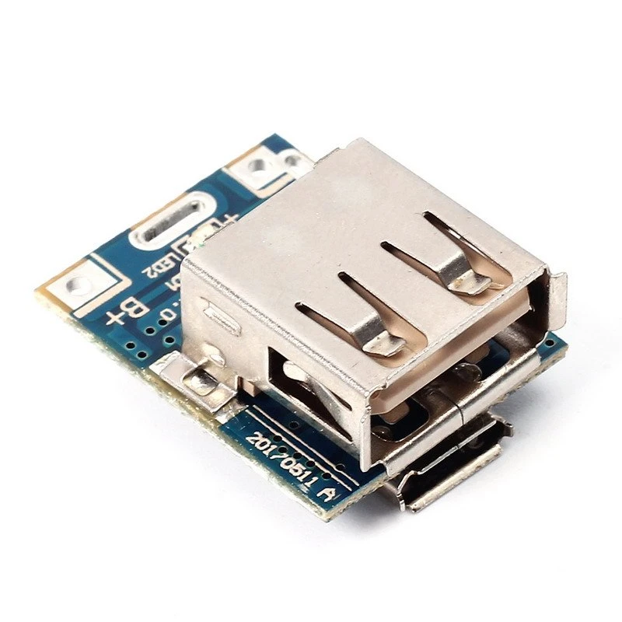
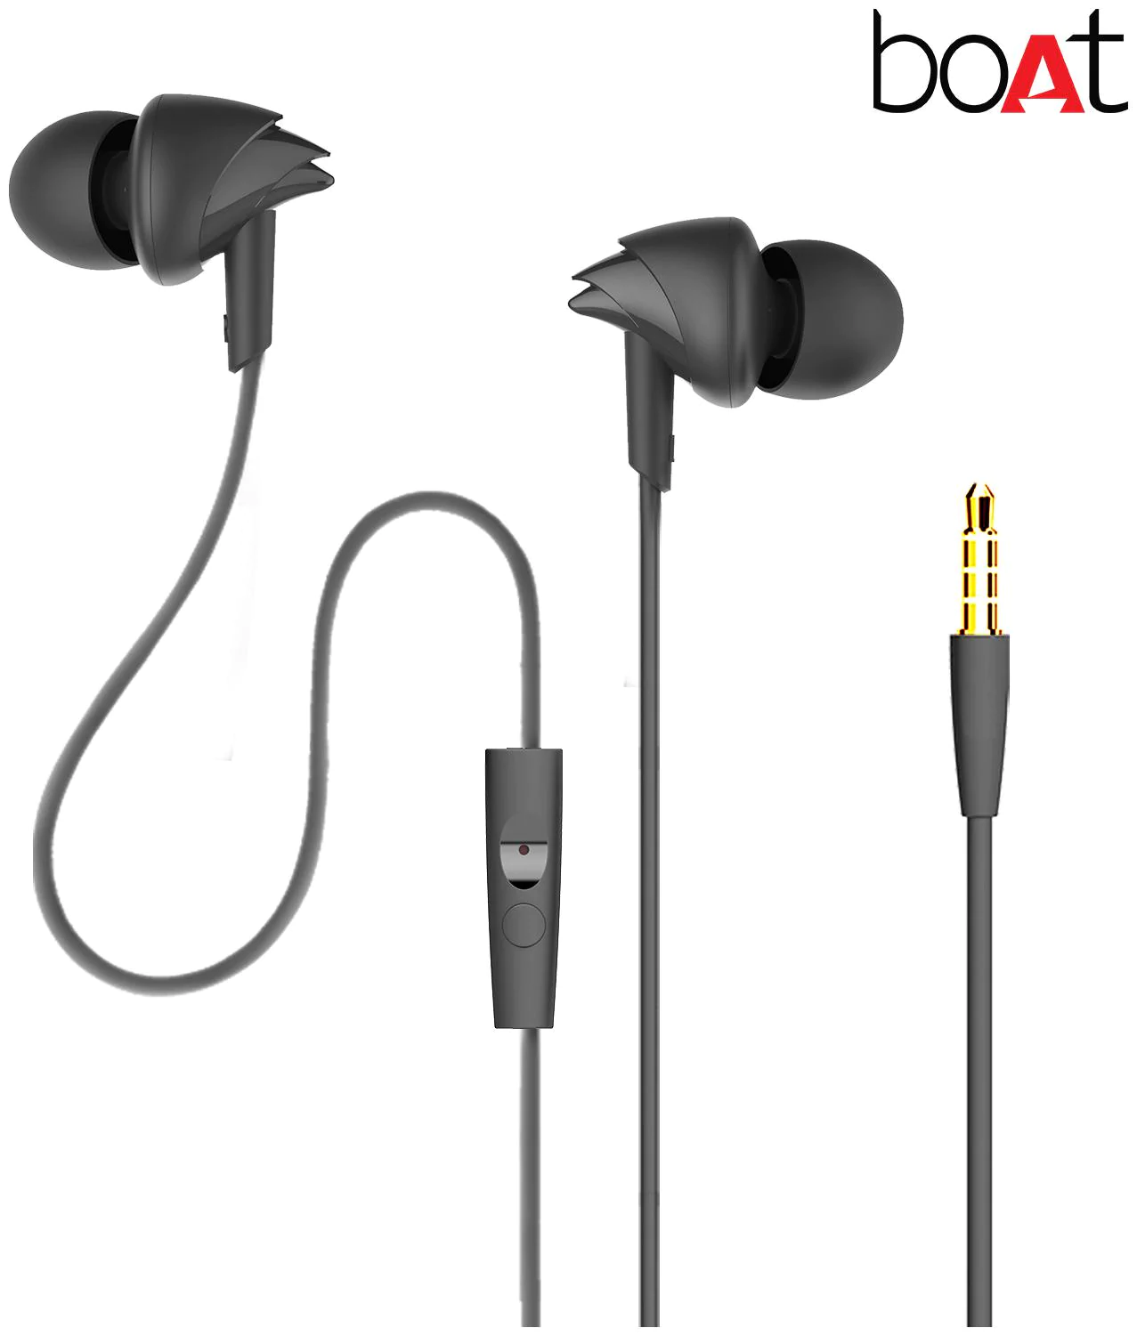
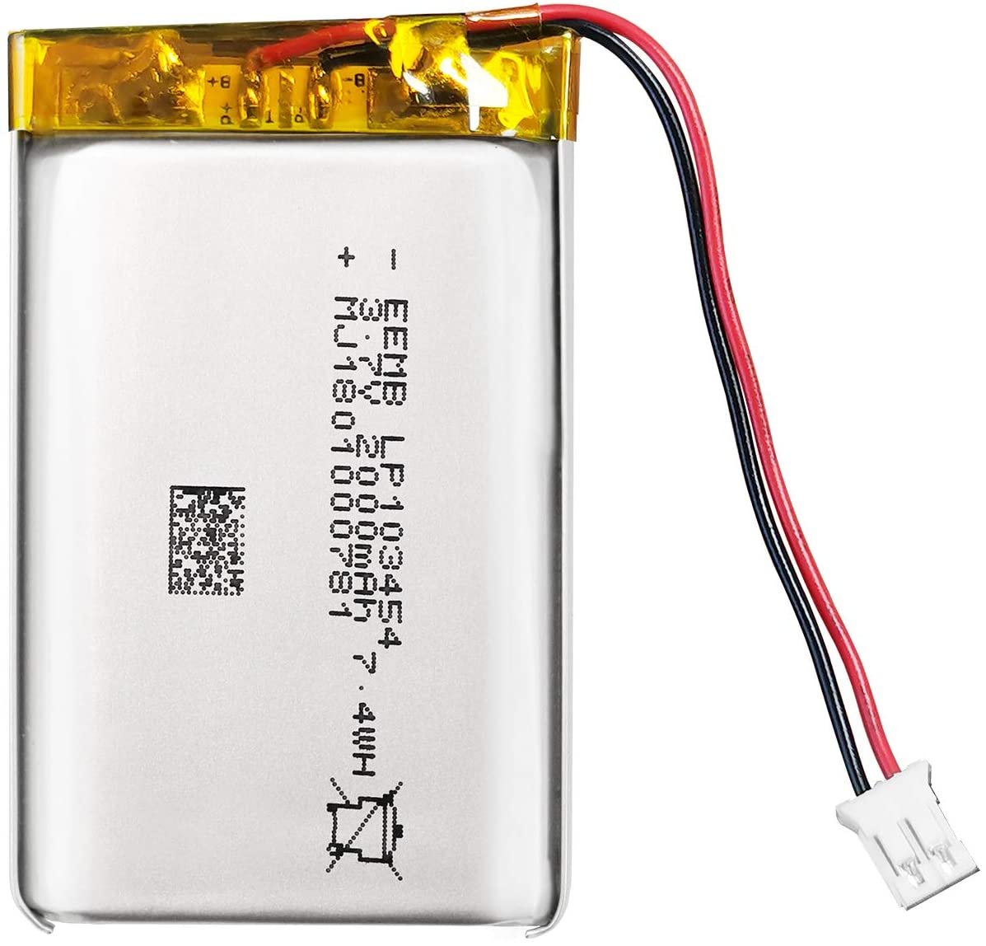
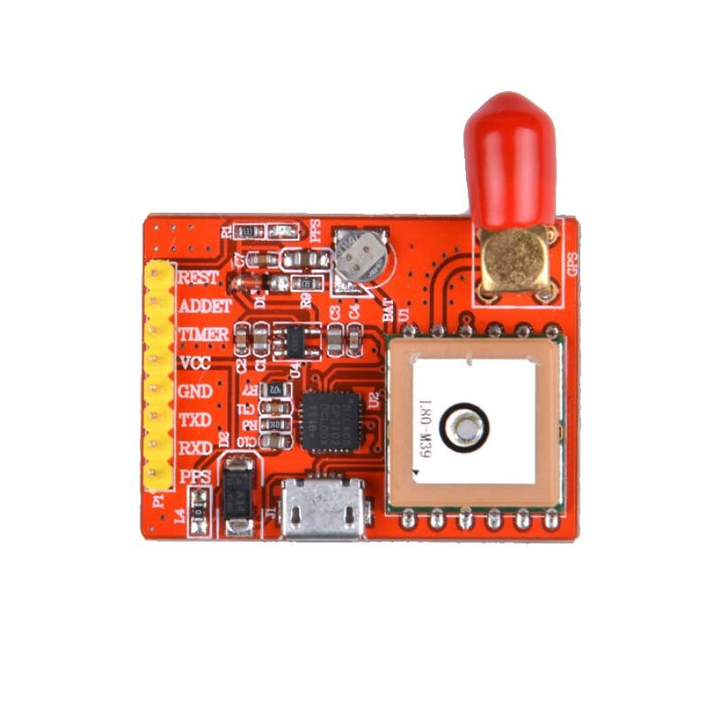
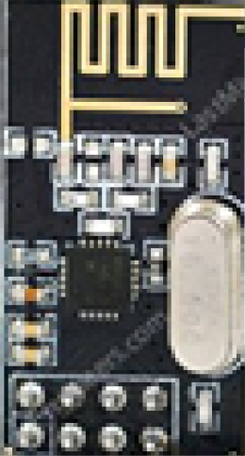
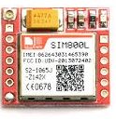
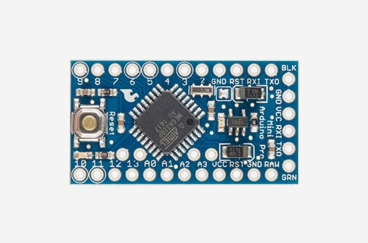
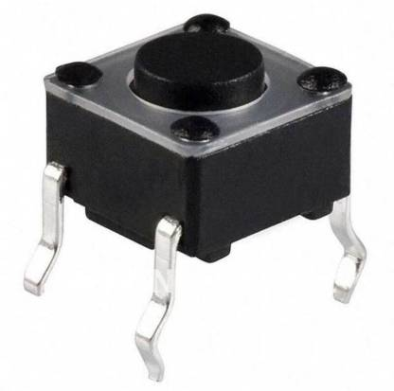
COMPONENTS
RASPBERRY PI ZERO W
RASPBERRY PI CAM
VIBRATOR
ULTRASONIC SENSOR
ACCELEROMETER
BSM
GPS MODULE
GSM MODULE
LiPO
BATTERY
PUSH
BUTTON
RF MODULE
HEADPHONES
ARDUINO MINI

Slide 8
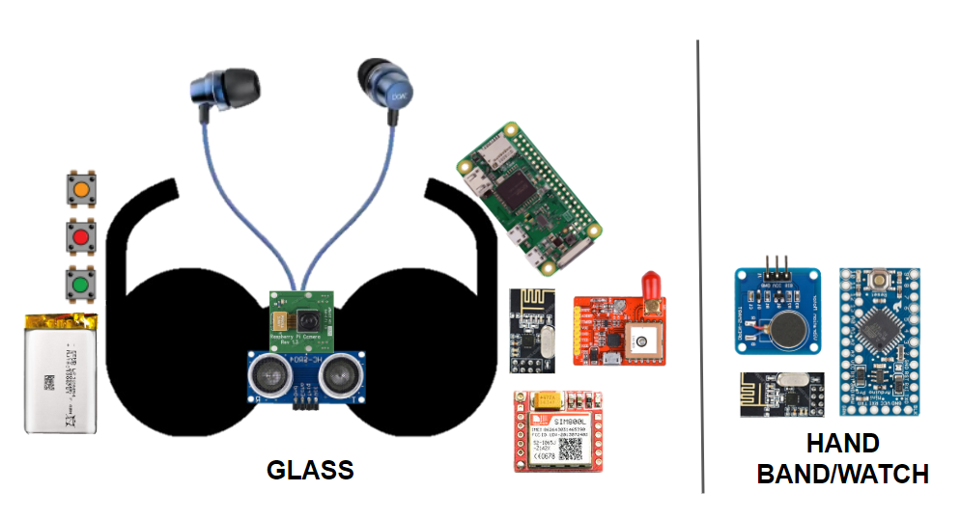
OVERALL LOOK OF PROTOTYPE

Slide 9
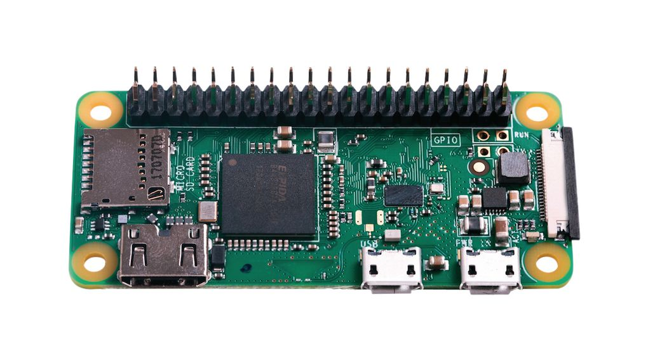

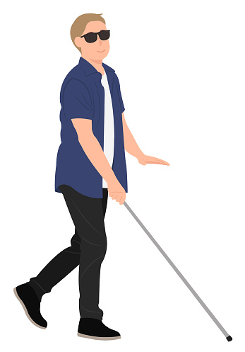
PROXIMITY DETECTION (ALWAYS ENABLED)
Raspberry pi 0 W
Ultrasonic Sensor
WATCH
RF MODULE
Vibrator
Arduino MINI
RF MODULE
9

Slide 10
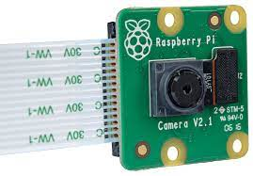
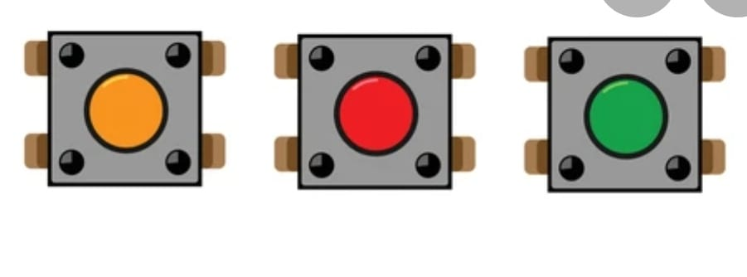

OBJECT DETECTION (WHEN BUTTON 1 IS PRESSED)
CAMERA MODULE
Raspberry pi 0 W
Audio Output
10

Slide 11



OCR (WHEN BUTTON 2 IS PRESSED)
CAMERA MODULE
Raspberry pi 0 W
Audio Output
Google
Text-to-Speech
11

Slide 12

FUTURE DEVELOPMENT (EMERGENCY MODE)
Raspberry pi 0 W
Accelerometer
CAMERA MODULE
DATABASE
GSM module
GPS module
12

Slide 13
FUTURE UPGRADATIONS
In this project, we have used YOLO V4 object detection algorithm which consists of 80 COCO datasets to detect an object. In future, we will use a custom dataset by using the TensorFlow algorithm.
A higher resolution camera - 12mp.
Use a microcontroller with better processing capabilities.
Features: Logo detection, Face detection, Navigational A
More compact and ergonomic design.
VLSI for maximized integration.

Slide 14
BUSINESS MODEL
Company Overview | VIS-B | OrCam MyEYE | Acesight | NuEyes Pro
Product | Visually Impaired Assistive Device |  | Low Vision Wearable Device
Target Market | India, Sri Lanka, Bangladesh, Nepal | Europe, USA | Europe, USA | Europe, USA
Pricing | Rs 10000 | Rs 268000 | Rs 382000 | Rs 459000
Strength | Proximity detection Object detection OCR Emergency alert Output in regional languages | Object detection OCR Control by hand gesture | Magnifies the surroundings Change Filters Control using remote | Magnifies the surroundings Control of device by voice input Gaming by connecting with phone Access the Internet for browsing and mailing
14

Slide 15
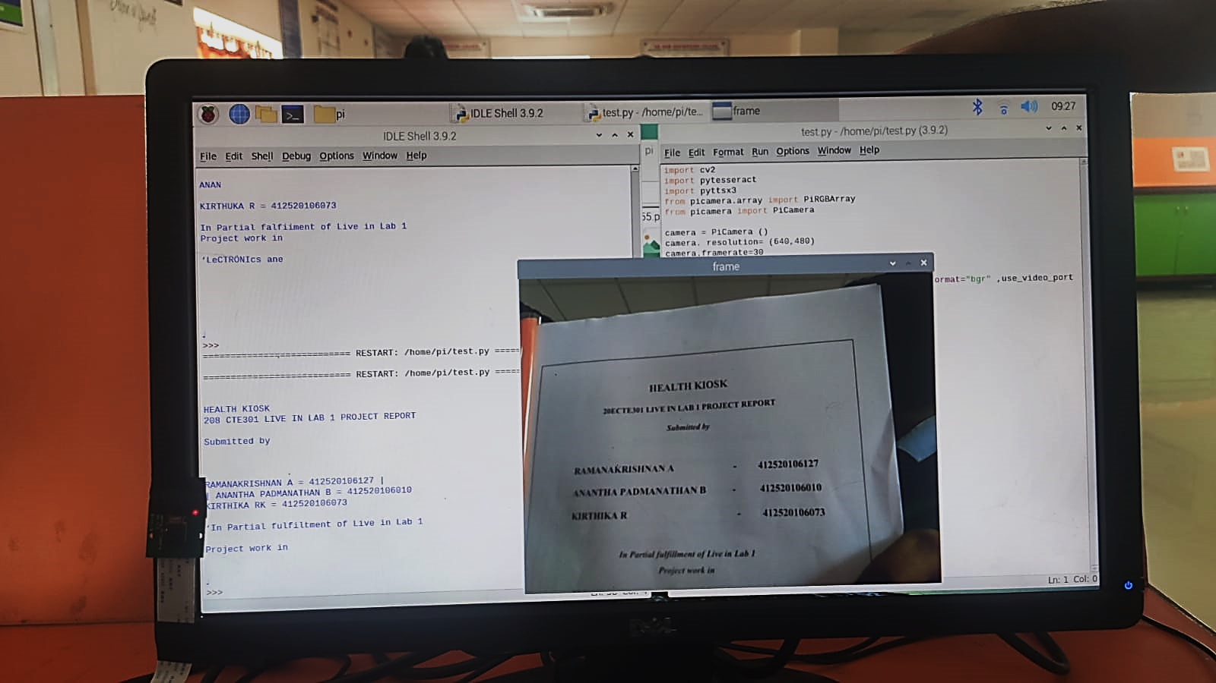
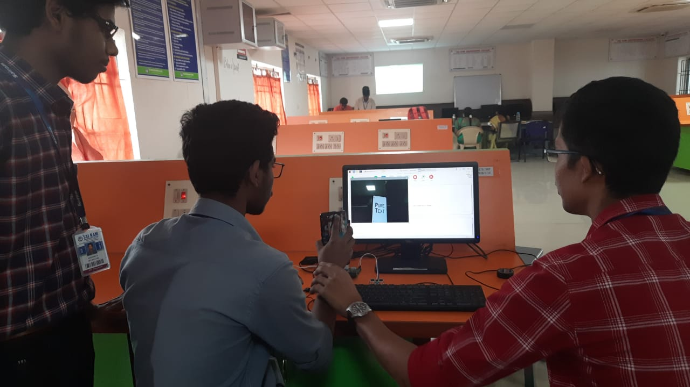
PROTOTYPING PROGRESS

Slide 16
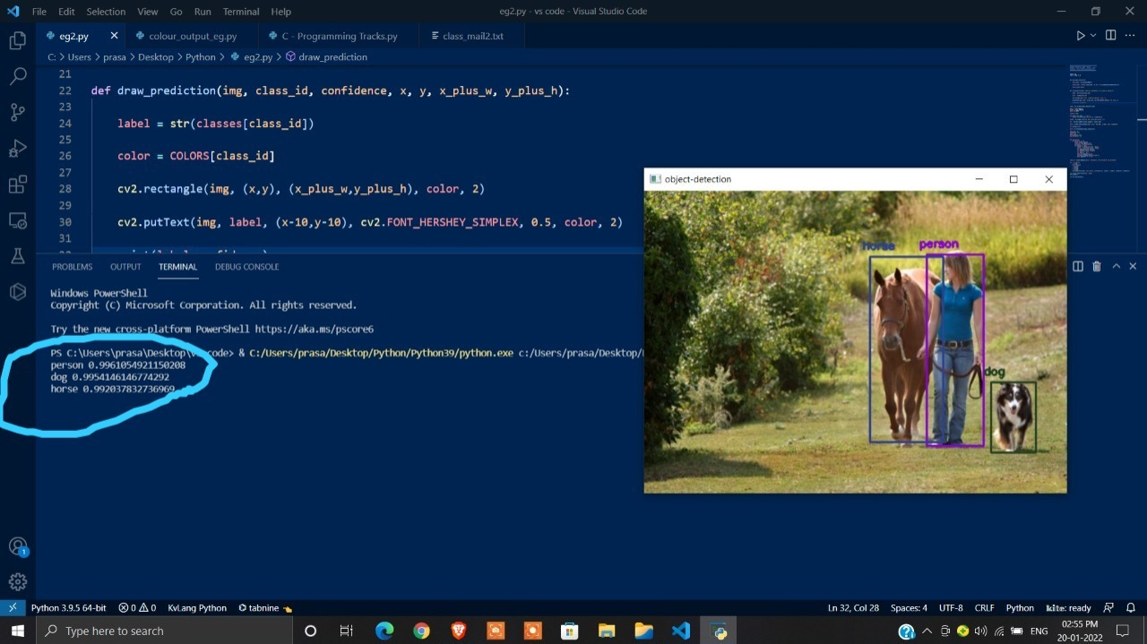
PROTOTYPING PROGRESS

Slide 17
CONCLUSION
A proximity detection, object recognition, text recognition and fall detection system has been proposed to help visually impaired people.
Audio output in regional languages of user’s preference is given.
The YOLO v4 is used to detect and recognize objects.
Open CV, Tesseract OCR and GTTS libraries are used to read text.
Accelerometer, GSM and GPS modules are used in emergency mode.
Ultrasonic Sensors are used for reasonable proximity detection.

Slide 18




